Slide 1
Research CoPilot
Multimodal RAG with Code Execution (RAG-CE)

Slide 2
Agenda
Process
Why do we need this?
Examples and Findings
User Interface
The Process
Ingestion
Search
Content Generation
Limitations
Improvements and Detection Process.
Error control
Live Demo

Slide 3
Why do we need this?

Slide 4
Existing Challenges
To be able to search through a knowledge base with RAG, text from documents need to be extracted, chunked and stored in a vector database
This process now is purely concerned with text:
If the documents have any images, graphs or tables, these elements are usually either ignored or extracted as messy unstructured text
Retrieving unstructured table data through RAG will lead to very low accuracy answers
LLMs are usually very bad with numbers. If the query requires any sort of calculations, LLMs usually hallucinate or make basic math mistakes

Slide 5
Why do we need this?
Ingest and interact with multi-modal analytics documents with lots of graphs, numbers and tables
Extract structured information from some elements in documents which wasn’t possible before:
Images
Graphs
Tables
Use the Code Interpreter to formulate answers where calculations are needed based on search results

Slide 6
Examples of Industry Applications
Analyze Investment opportunity documents for Private Equity deals
Analyze tables from tax documents for audit purposes
Analyze financial statements and perform initial computations
Analyze and interact with multi-modal Manufacturing documents
Process academic and research papers
Ingest and interact with textbooks, manuals and guides
Analyze traffic and city planning documents

Slide 7
Examples and Findings

Slide 8
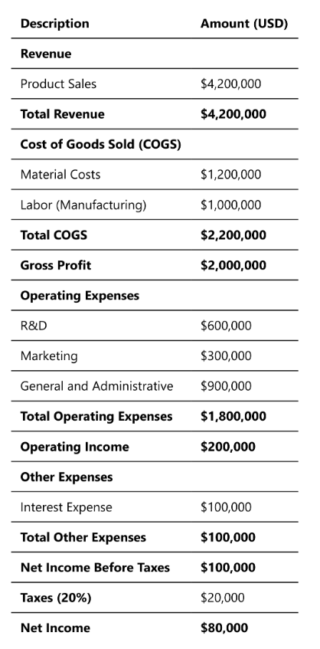
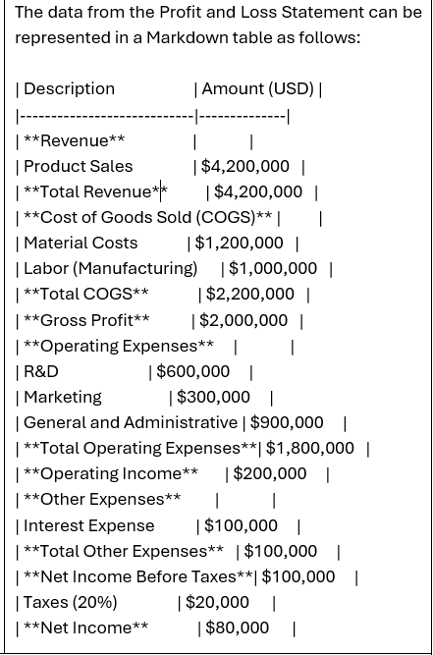
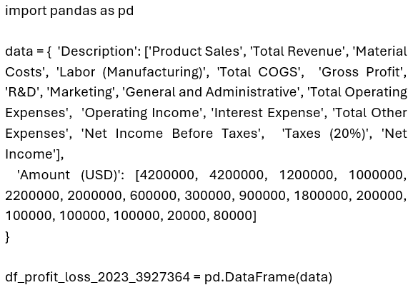
Table Extraction – Data Table
Original Table
Generated Python and Markdown

Slide 9
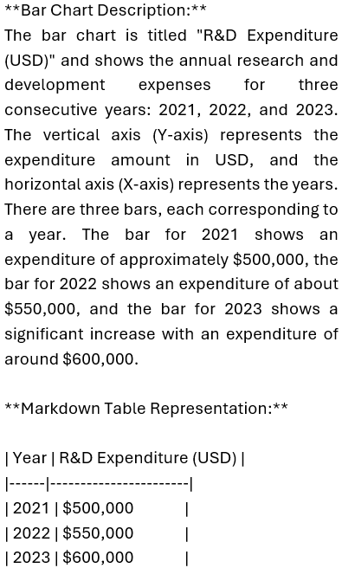
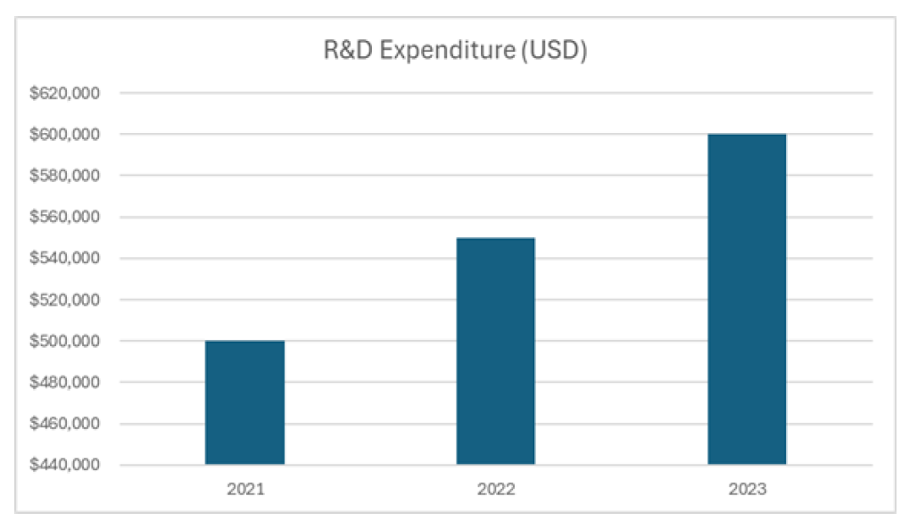
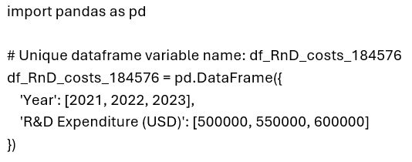
Table Extraction - Graph
Original Table
Generated Python and Markdown

Slide 10
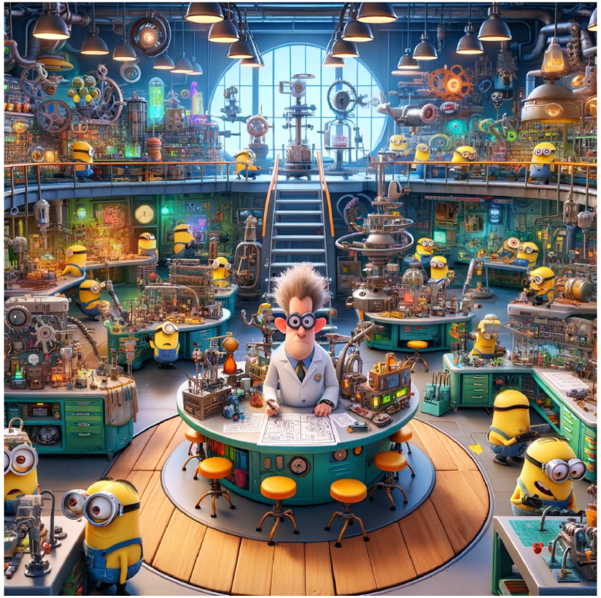
Image Explanation
Image
Excerpts from the Text Explanation
The image depicts a vibrant and busy laboratory setting filled with numerous minions, which are small, yellow, cylindrical creatures wearing goggles and blue overalls. The laboratory is packed with a variety of whimsical and colorful machinery, gadgets, and equipment that give off a cartoonish and inventive vibe.
There are multiple levels to the laboratory, connected by stairs and walkways. The minions are engaged in various activities, some are working on machinery, others are carrying objects, and a few are interacting with each other. The central area features a round platform with a character standing at a desk, surrounded by stools. The character's face is blurred, but they appear to be working on a blueprint or design. The overall setting is indoors, with large windows allowing natural light to illuminate the space, and the walls are lined with shelves holding various tools and devices.

Slide 11
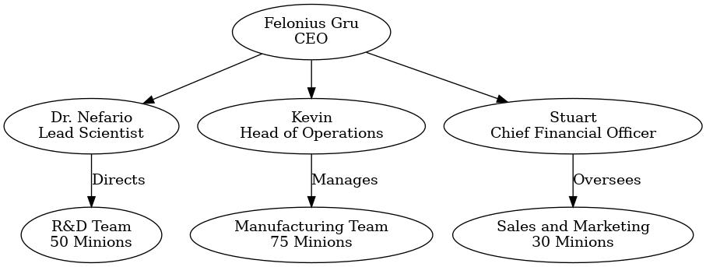
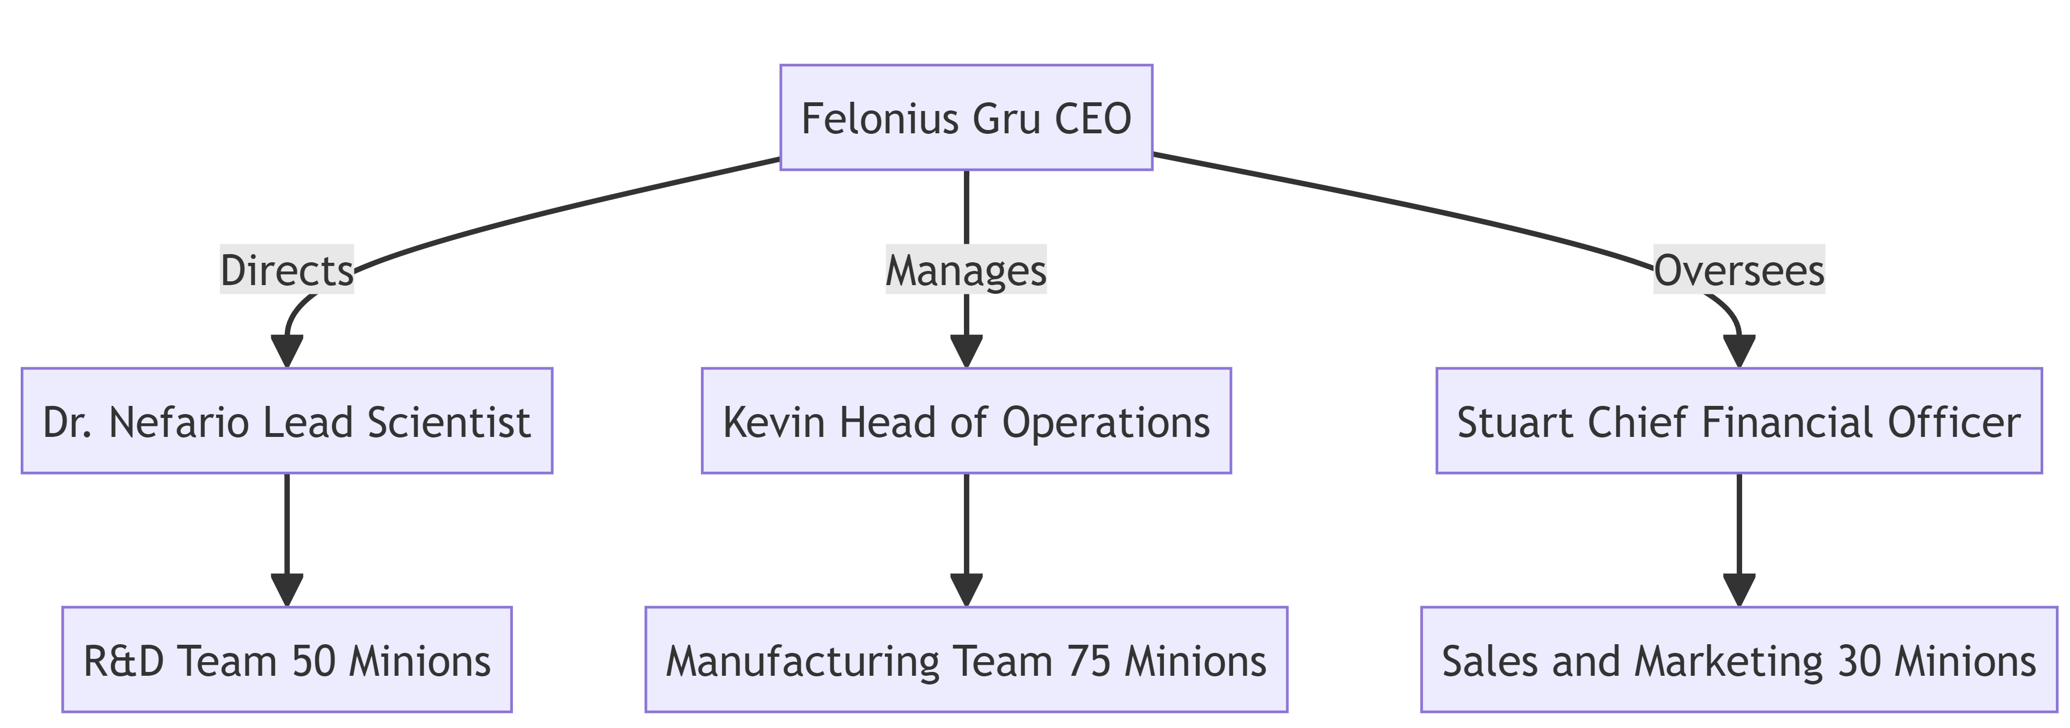
Mermaid
Original Image
Extracted Mermaid Code
graph TD;
CEO[Felonius Gru CEO] -->|Directs| LS[Dr. Nefario Lead Scientist]
CEO -->|Manages| HO[Kevin Head of Operations]
CEO -->|Oversees| CFO[Stuart Chief Financial Officer]
LS --> RnD[R&D Team 50 Minions]
HO --> Manu[Manufacturing Team 75 Minions]
CFO --> SnM[Sales and Marketing 30 Minions]
Link

Slide 12
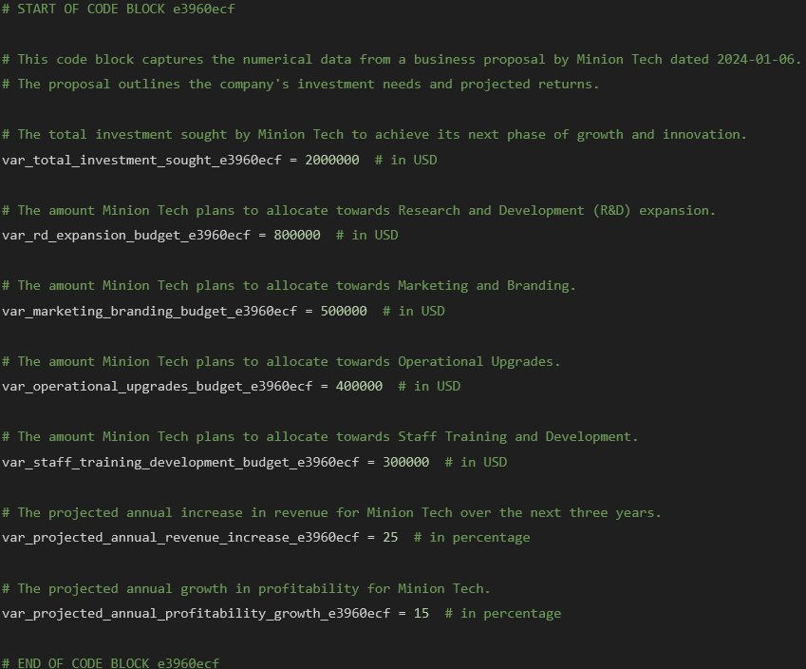
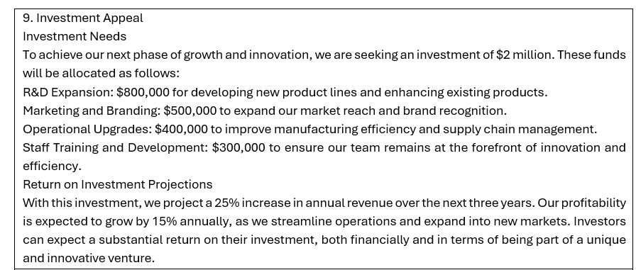
Numbers - Code Harvesting from Plain Text
Processed Extracted Text
Harvested Code

Slide 13
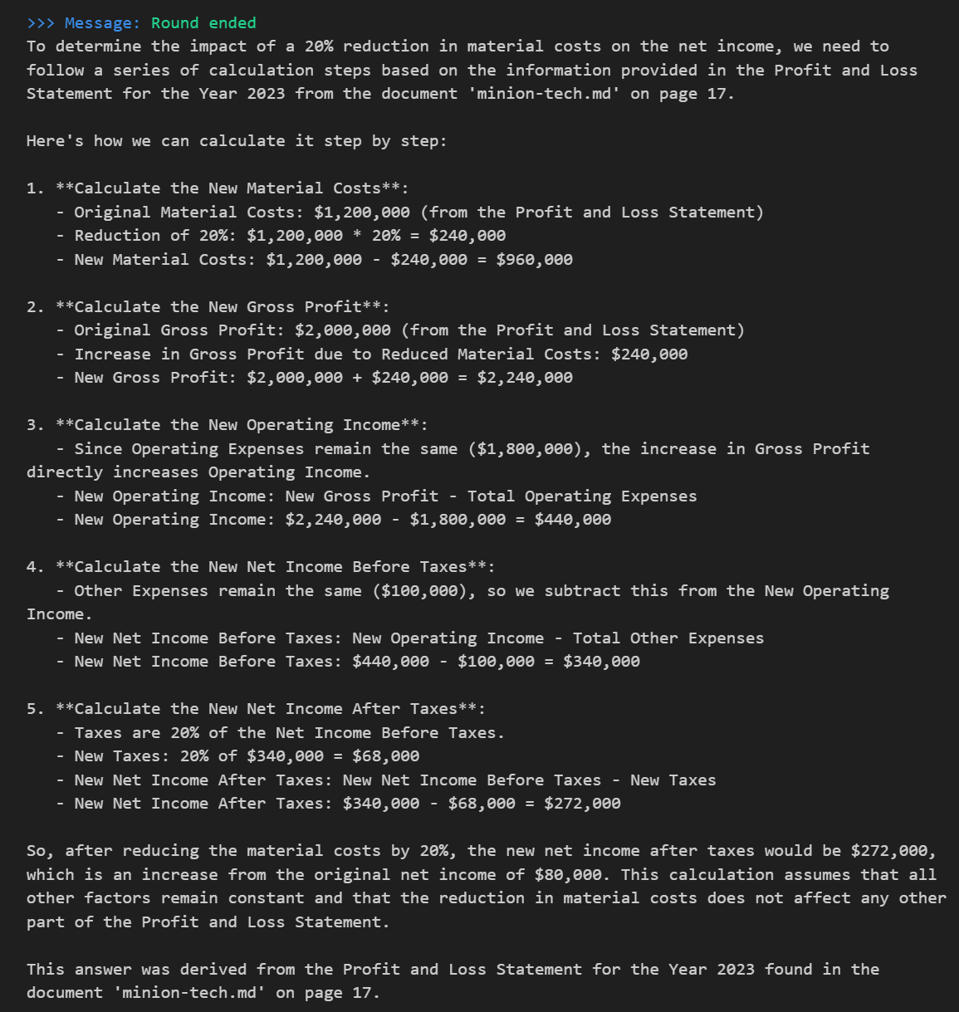
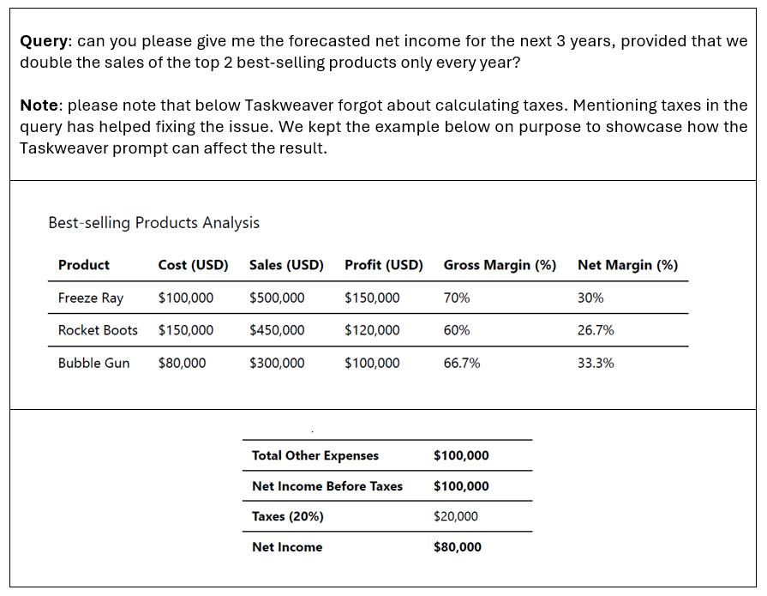
RAG-CE: Using Taskweaver

Slide 14
Findings
GPT-4-Turbo is a great help with its large 128k token window
GPT-4-Turbo with Vision is great at extracting tables from unstructured document formats
GPT-4 models can understand a wide variety of formats (Python, Markdown, Mermaid, GraphViz DOT, etc..) which was essential in maximizing information extraction
A new approach to vector index searching based on tags was needed because the Generation Prompts were very lengthy compared to the usual user queries
Taskweaver’s and Assistants API’s Code Interpreters were introduced to conduct open-ended analytics questions

Slide 15
User Interface

Slide 16
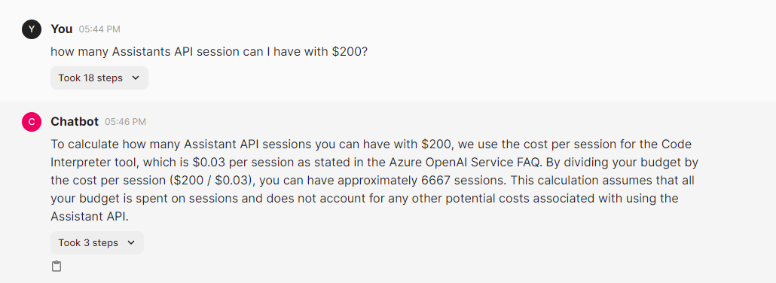
User interface

Slide 17
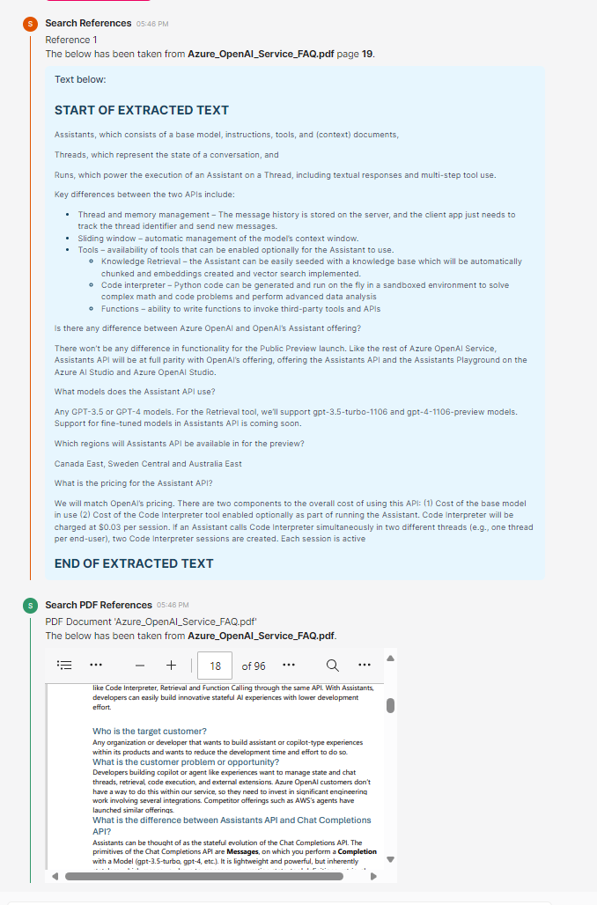
References in the UI
References that can be easily be read
PDF Viewer of the reference document as part of the information audit trail

Slide 18
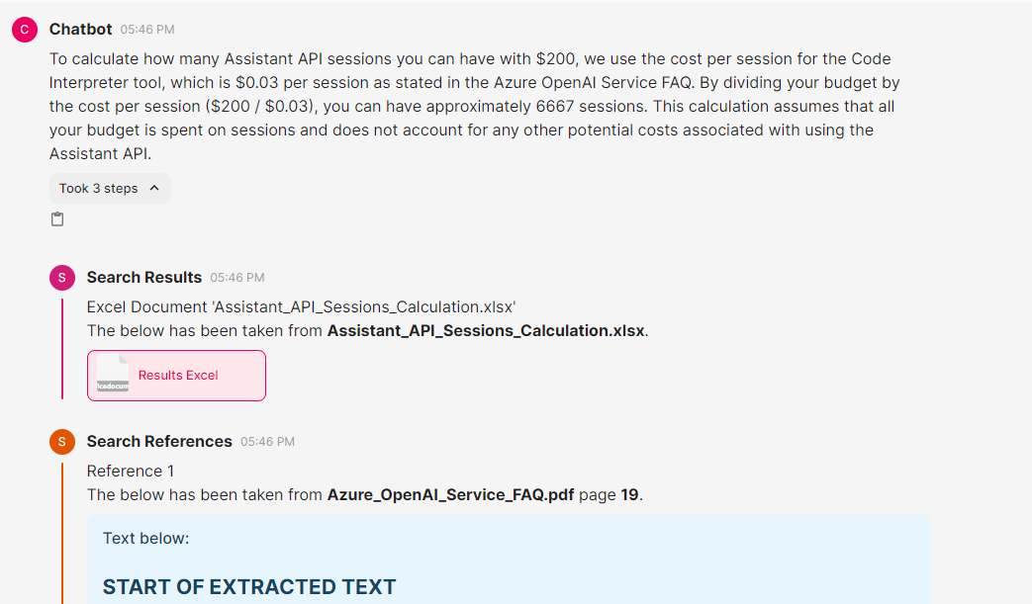
User Interface – A full Audit Trail
Automatically generated Excel sheet by Taskweaver or Assistants API that includes the numbers mentioned in the final answer, so that the user has a working version to interact with.

Slide 19
The Process

Slide 20
Overall approach
Phase 1: Ingestion Design and Implementation
Phase 2: Search Design and Implementation
Phase 3: Generation Design and Implementation

Slide 21
Phase 1: Exploration overview
Data analysis of the source documents provided by ADIA.
3 Screening outputs for 3 different cases
Set of input documents per case
Open AI models evaluation:
GPT 4 Turbo
GPT 4 Vision
Ada
GPT-35-Turbo
Framework assessed: Autogen, Taskweaver
Python Libraries assessed: many PDF processing packages, visual processing packages of tables

Slide 22
Phase 2: Document Ingestion Process
Document Conversion: All documents, including MS Word and Powerpoint, are first converted to PDF format (for now manually, but can be programmatic)
Page-Level Processing: Each PDF is broken into pages, with text extraction, image and table detection using GPT-4 and GPT-4V, followed by post-processing of images and tables.
Content Analysis and Saving: Extracted text is enhanced for readability with GPT-4, images and tables are described and converted to Markdown or Mermaid code, and relevant data is harvested as Python code.
Consolidation and Indexing: All processed content (text, image descriptions, table data) is consolidated per page and pushed into a vector index (Cognitive Search) with metadata including file links and page details.

Slide 23
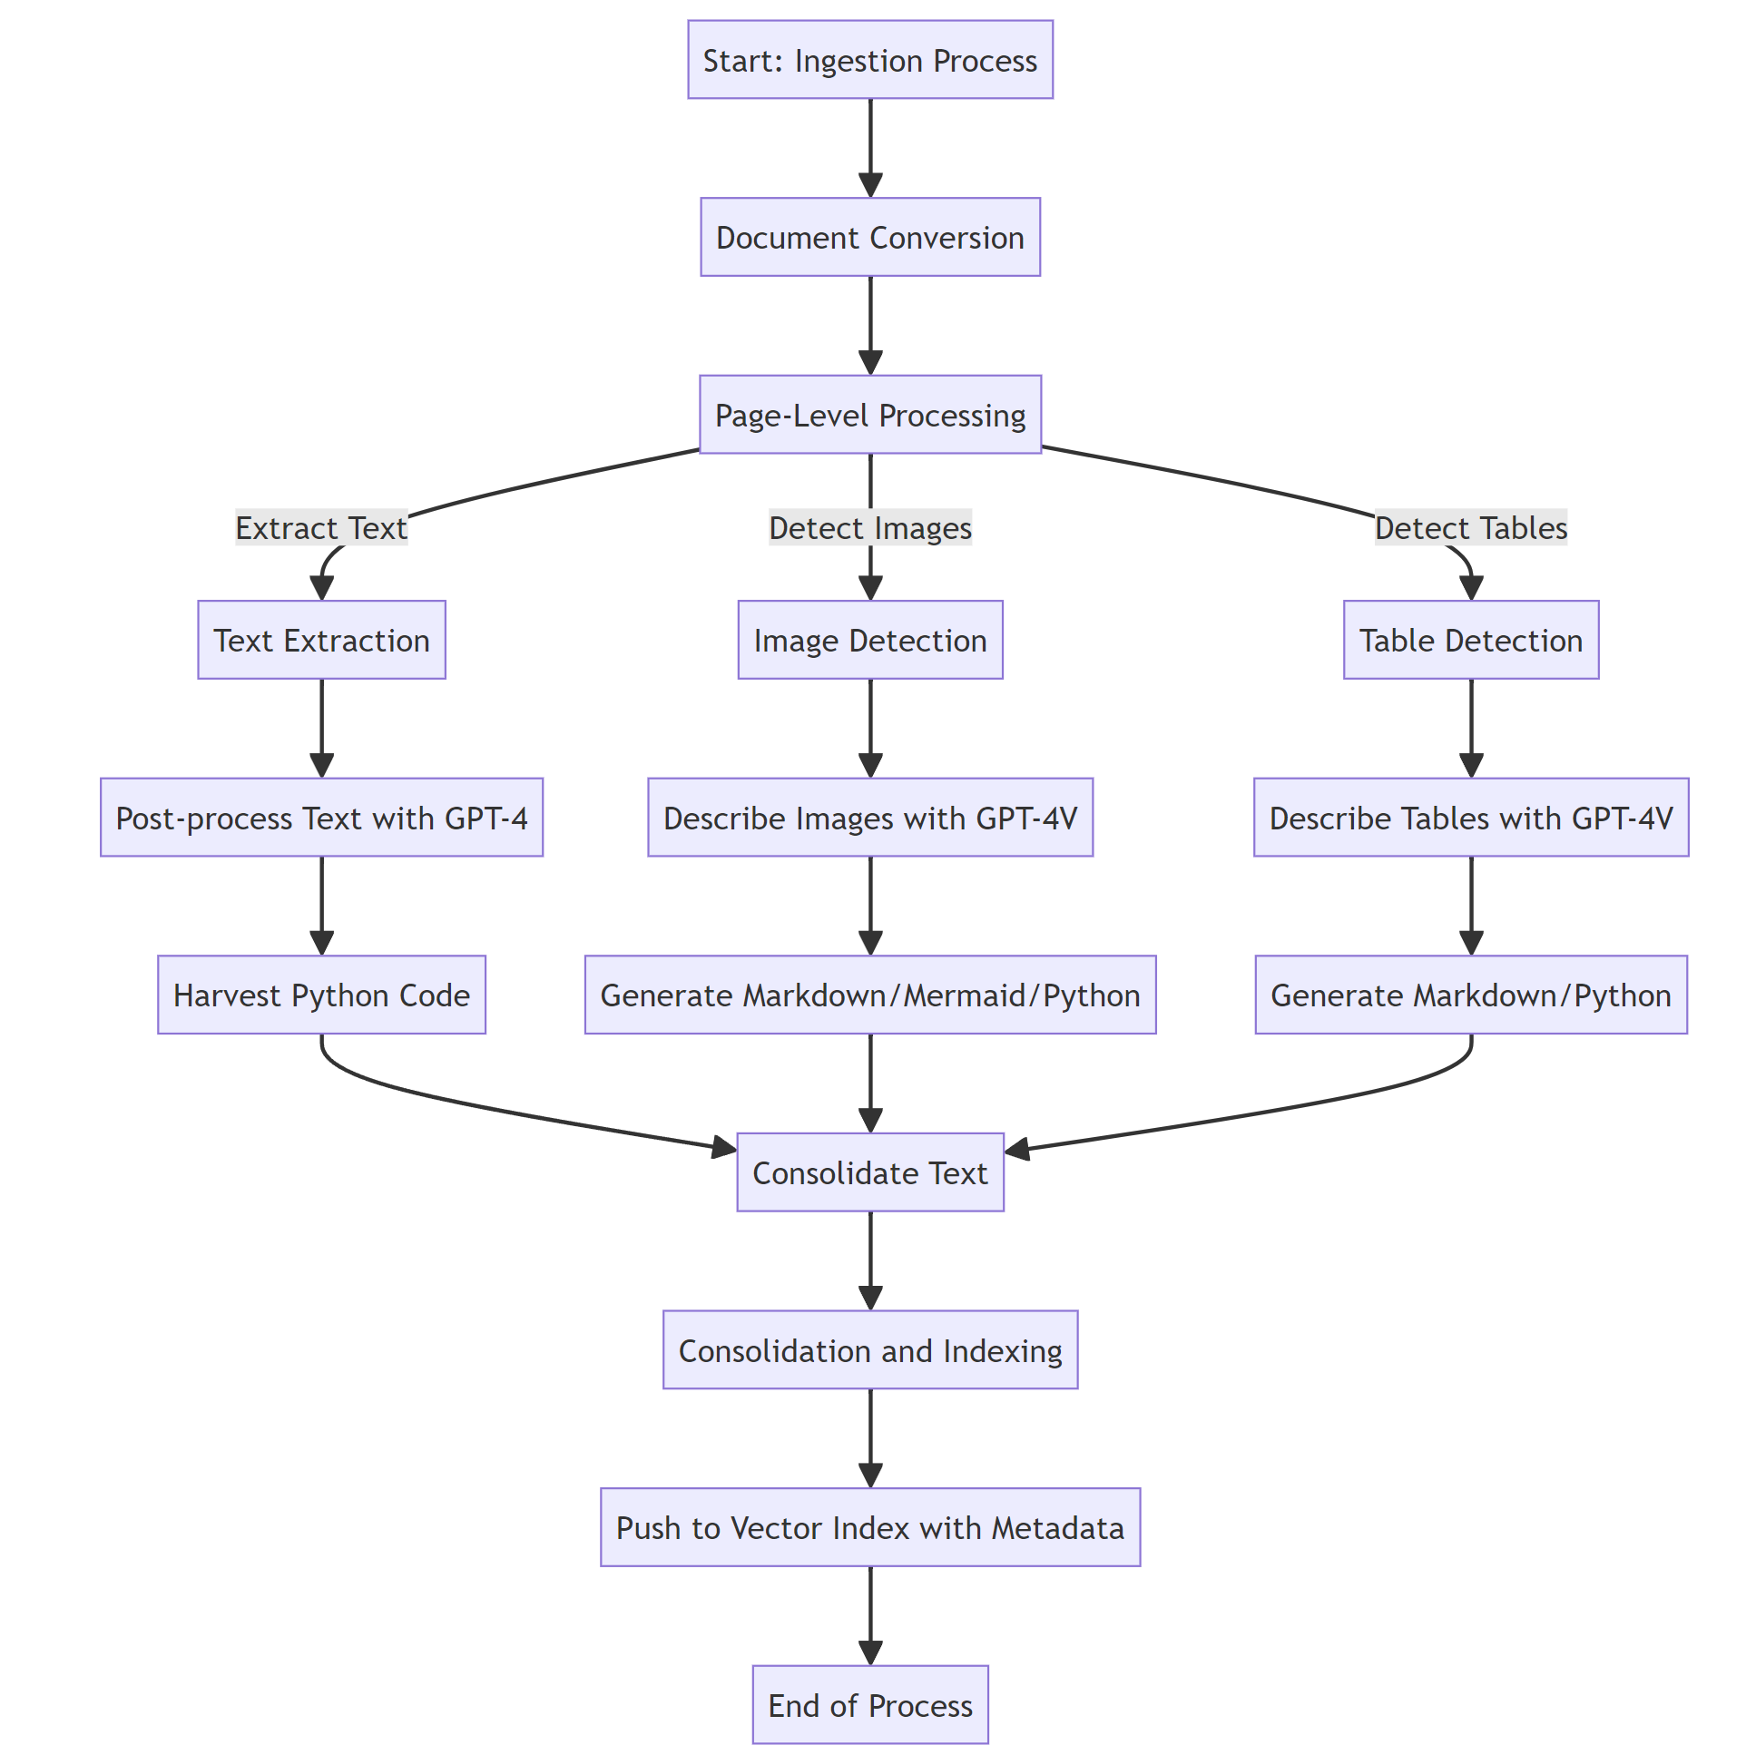
Phase 2: Document Ingestion Process Text, Images, Tables

Slide 24
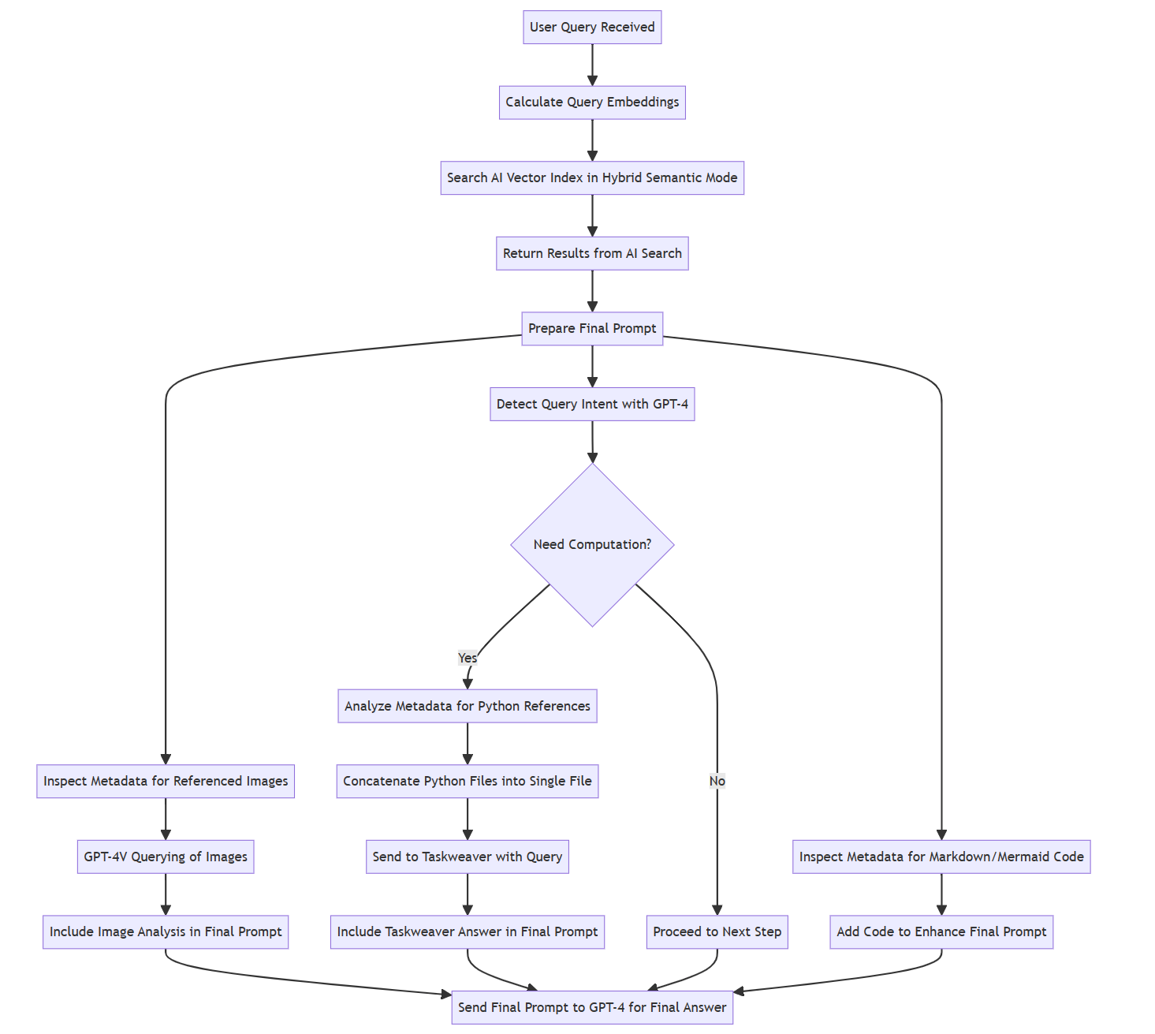
Phase 3: Search Process
Based on a new tag-generated technique
Taskweaver is a MS-developed OSS library, and acts as a Code Interpreter with a Planner (2 Agents).
It’s designed as a “Code-first” approach, which means the objects passed between Agents are Python native (so no need for string parsing).
Code Interpreter for Computation

Slide 25
Phase 4: Content Generation
Reverse engineering using GPT 4 Turbo and Vision.
Processing the screening main sections through these models.
Summarization and sanitization of data.
Prompt engineering techniques
Prompt versioning exponential addition.
Dynamic prompting techniques by Industry and Section.
Model Self-evaluation.
Correlation with the ingested data and AI search output to show relevant context information to the PED analyst.

Slide 26
Limitations

Slide 27
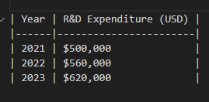
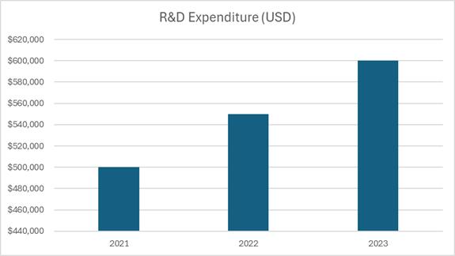
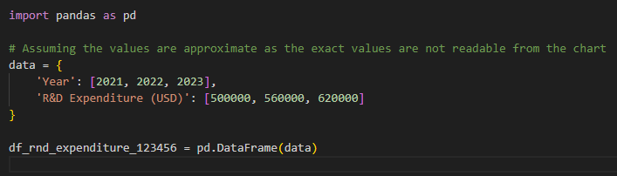
Limits of GPT-4V – Problems in Table and Graph Extraction

Slide 28
Error and Hallucination Detection
We need a Human-in-the-loop
Images or tables might be incorrectly read by the GPT models
When it comes to Search, fallacies in the logic for producing the result might exist
How do we manage this? There are 2 complementing ways:
Error Detection: with each generated answers, references are generated by the LLM for cross-checking
Error Correction: if an error was detected in the ingested document, a UI view can be built to manually correct the error, and re-commit the contents as a file and in the vector store

Slide 29
Live Demo

